Slide 1
REGULAR EXPRESSIONS
Shekh. Md. Saifur Rahman
Lecturer, CSE Department
UIU

Slide 2
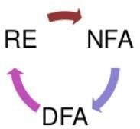
Introduction
A language is called a regular language if some finite automaton(DFA) recognizes it.
A language is regular if and only if some nondeterministic finite automaton(NFA) recognizes it.
If a language is described by a regular expression (RE), then it is also regular.
Lecturer Saifur Rahman, Dept. of CSE, United International University

Slide 3
Introduction
In arithmetic, we can use the operations + and × to build up expressions such as (5 + 3) × 4.
Similarly, we can use the regular operations to build up expressions describing languages.
These are called regular expressions.
An example is:
(0 ⋃ 1)0*
Lecturer Saifur Rahman, Dept. of CSE, United International University

Slide 4
Importance
REs have an important role in computer science applications. It provides powerful methods to describe different string patterns in UNIX commands, modern programming languages, text editors etc.
REs is heavily used in pattern matching.
Patterns are very flexible and provide us with a way to make our own pattern to validate the input.
Regular expressions are useful in search and replace operations. The typical use case is to look for a sub-string that matches a pattern and replace it with something else.
Lecturer Saifur Rahman, Dept. of CSE, United International University

Slide 5

Before going further, a small recap
3 operations are defined on languages called Regular Operations.
Here, the name Regular Operations is just a name that has been chosen for these 3 operations. Regular Operations are used to study properties of the Regular Languages.
Definition: Let Σ be an alphabet and A,B ⊆ Σ* be languages. Then the regular operations are as follows:
Lecturer Saifur Rahman, Dept. of CSE, United International University

Slide 6
Example
Let, Alphabet Σ = { a, b, c, … … … , z }
Language A = { good, bad } ⊆ Σ*
Language B = { boy, girl } ⊆ Σ*
Then,
A⋃B = { good, bad, boy, girl }
AB = { goodboy, goodgirl, badboy, badgirl }
A* = { 𝜀, good, bad, goodgood, goodbad, badgood, badbad, goodgoodgood, goodgoodbad, … … }
Lecturer Saifur Rahman, Dept. of CSE, United International University

Slide 7
Closure Property
The regular languages are closed with respect to the regular operations: if A, B ⊆ Σ* are regular languages, then the languages A⋃B, AB, and A* are also regular.
Lecturer Saifur Rahman, Dept. of CSE, United International University

Slide 8
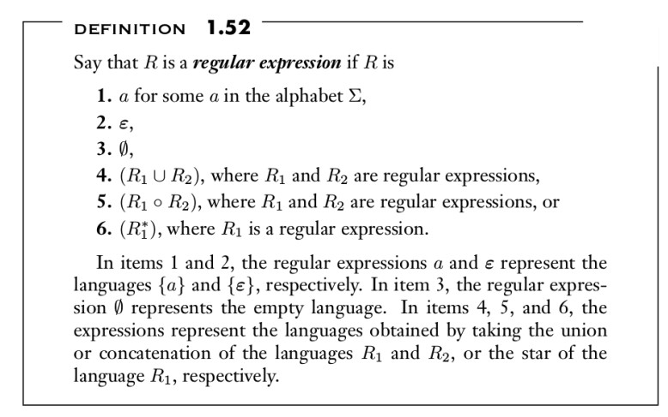
Regular Expressions - Definition
Lecturer Saifur Rahman, Dept. of CSE, United International University

Slide 9
Regular Expression – Precedence Order
Parentheses
Star
Concatenation
Union
So according to the precedence sequence:
(ab U a)* = ( ( (a) (b) ) U ( a ) ) *
Lecturer Saifur Rahman, Dept. of CSE, United International University

Slide 10
Let’s get our hands dirty
In the following instances, we assume that the alphabet Σ is { 0 , 1 }
0* 1 0*
{ w | w contains a single 1 }
0* 1 0* 1 0* 1 0*
{ w | w consists of exactly three 1’s }
Σ* 1 Σ*
{ w | w has at least a single 1 }
Σ* 001 Σ*
{ w | w has the string 001 as a substring }
Lecturer Saifur Rahman, Dept. of CSE, United International University

Slide 11
Example - Continued
{ w | w contains at least three 1’s }
- (0 | 1)* 1 (0 | 1)* 1 (0 | 1)* 1 (0 | 1)*
{ w | w has at most one 1 }
- 0* | 0* 1 0*
{ w | w contains an even number of 1’s }
- (0* 1 0* 1 0*)* 0*
{ w | the number of 1’s within w can be evenly divided by 3 }
- (0* 1 0* 1 0* 1 0* )* 0*
Lecturer Saifur Rahman, Dept. of CSE, United International University

Slide 12
Example - Continued
{ w | w is a string of even length }
- (ΣΣ)*
{ w | the length of w is a multiple of 3 }
- (ΣΣΣ)*
Lecturer Saifur Rahman, Dept. of CSE, United International University

Slide 13
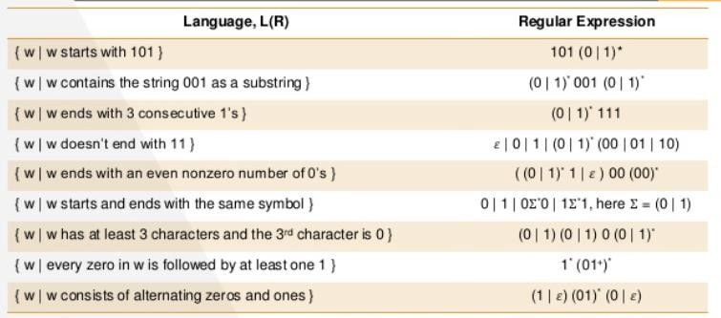
Practices
Lecturer Saifur Rahman, Dept. of CSE, United International University

Slide 14
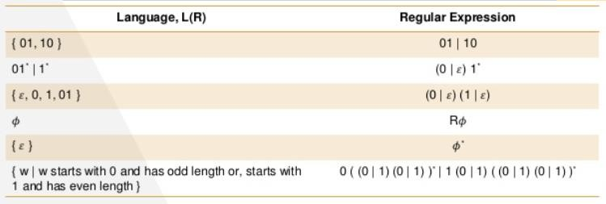
Practices
Lecturer Saifur Rahman, Dept. of CSE, United International University

Slide 15
RE – Equivalence with Finite Automata
Regular expressions and finite automata are equivalent in their descriptive power.
This fact is surprising because finite automata and regular expressions superficially appear to be rather different.
However, any regular expression can be converted into a finite automaton that recognizes the language it describes, and vice versa.
Recall that a regular language is one that is recognized by some finite automaton.
Lecturer Saifur Rahman, Dept. of CSE, United International University

Slide 16
RE – Equivalence with Finite Automata
This theorem has two directions.
We state and prove each direction as separate lemma
Lecturer Saifur Rahman, Dept. of CSE, United International University

Slide 17
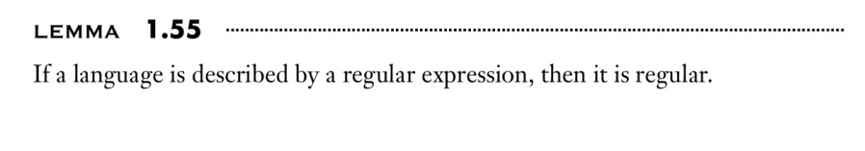
RE → NFA
Say that we have a regular expression R describing some language A.
We show how to convert R into an NFA recognizing A.
We have previously learned that, if an NFA recognizes A then A is regular. Let’s convert R into an NFA N.
We consider the six cases in the formal definition of regular expressions.
Lecturer Saifur Rahman, Dept. of CSE, United International University

Slide 18

RE → NFA
1. R = a for some a ∈ Σ. Then L(R) = { a } the following NFA recognizes L(R)
Lecturer Saifur Rahman, Dept. of CSE, United International University

Slide 19
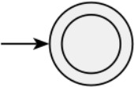
RE → NFA
2. R = 𝜀 . Then L(R) = { 𝜀 },
the following NFA recognizes L(R)
Lecturer Saifur Rahman, Dept. of CSE, United International University

Slide 20
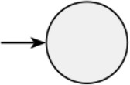
RE → NFA
3. R = 𝜙 .
Then L(R) = 𝜙
Lecturer Saifur Rahman, Dept. of CSE, United International University

Slide 21
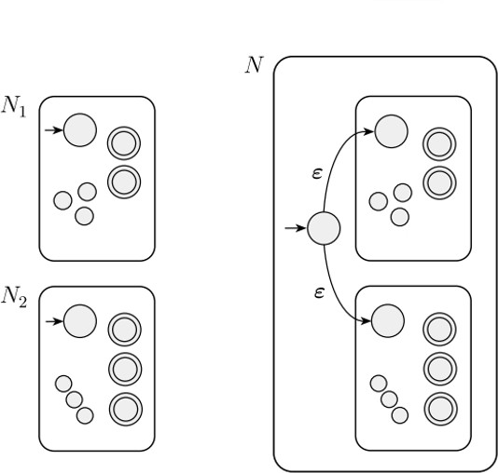
RE → NFA
4. R = 𝑅₁ U 𝑅₂, so L(R) = L(𝑅₁) U L(𝑅₂) =
𝑁𝐹𝐴₁ recognizes L(𝑅₁) U 𝑁𝐹𝐴₂ recognizes L(𝑅₂)
Lecturer Saifur Rahman, Dept. of CSE, United International University

Slide 22
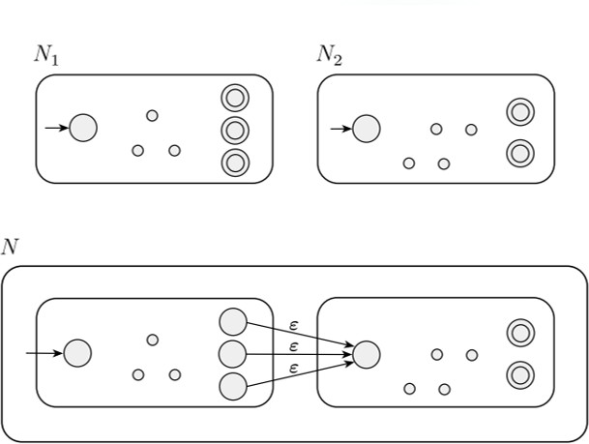
RE → NFA
5. R = 𝑅₁ o 𝑅₂ = 𝑅₁𝑅₂ = L(𝑅₁) o L(𝑅₂) = 𝑁𝐹𝐴₁
recognizes L(𝑅₁) o 𝑁𝐹𝐴₂ recognizes L(𝑅₂)
Lecturer Saifur Rahman, Dept. of CSE, United International University

Slide 23
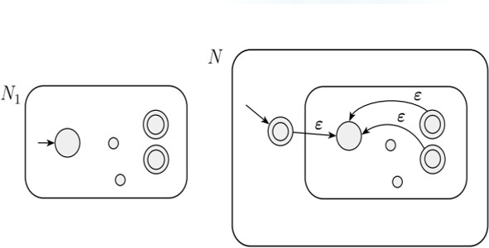
RE → NFA
6. R = 𝑅₁ * = L(𝑅₁)* = (𝑁𝐹𝐴₁ recognizes L(𝑅₁))*
Lecturer Saifur Rahman, Dept. of CSE, United International University

Slide 24
RE → NFA
We use the constructions given in the proofs that the class of regular languages is closed under the regular operations.
In other words, we construct the NFA for R from the NFA’s for 𝑅₁ and 𝑅₂ (or just 𝑅₁ in case 6) and the appropriate closure construction.
Lecturer Saifur Rahman, Dept. of CSE, United International University

Slide 25


Convert the following RE to equivalent NFA
ab U a)*
Lecturer Saifur Rahman, Dept. of CSE, United International University

Slide 26

Convert the following RE to equivalent NFA
(ab U a)*
Lecturer Saifur Rahman, Dept. of CSE, United International University

Slide 27
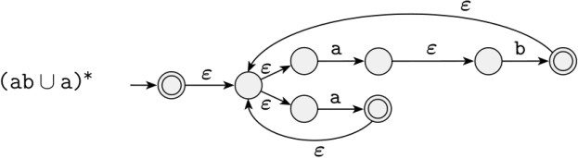
(ab U a)*
Lecturer Saifur Rahman, Dept. of CSE, United International University

Slide 28
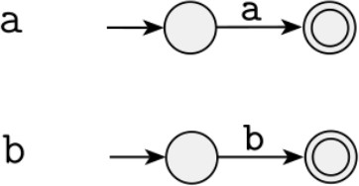
(a U b)*aba
Lecturer Saifur Rahman, Dept. of CSE, United International University

Slide 29
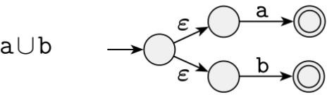
(a U b)*aba
Lecturer Saifur Rahman, Dept. of CSE, United International University

Slide 30
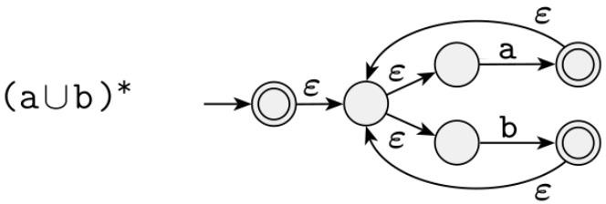
(a U b)*aba
Lecturer Saifur Rahman, Dept. of CSE, United International University

Slide 31
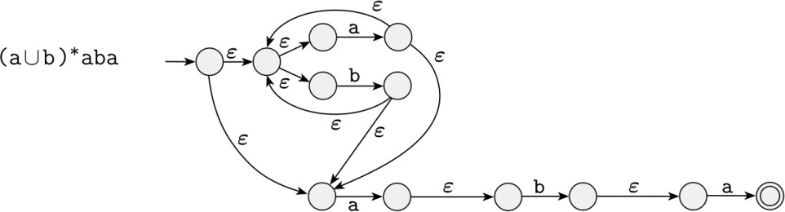
(a U b)*aba
Lecturer Saifur Rahman, Dept. of CSE, United International University

Slide 32
RE → NFA : Practices
( a U b ) * a b a
( 0 U 1 ) * 0 0 0 ( 0 U 1 )* = Σ* 0 0 0 Σ* where Σ = 0, 1 = 0 U 1
( ( ( 0 0 )* ( 1 1 ) ) U 0 1 ) *
( 0 1 U 0 0 1 U 0 1 0 ) *
a ( a b b ) * U b a+ U ( a b ) +
( a U b+ ) a+ b+ [ Hint: replace a+ with (a a*) ]
1* ( 0 1+)* ( Σ Σ Σ ) *
0 Σ* 0 U 1 Σ* 1 U 0 U 1
𝜙*
( 0 U 𝜀 ) 1*
Lecturer Saifur Rahman, Dept. of CSE, United International University

Slide 33
FA → RE ?
Lecturer Saifur Rahman, Dept. of CSE, United International University

Slide 34
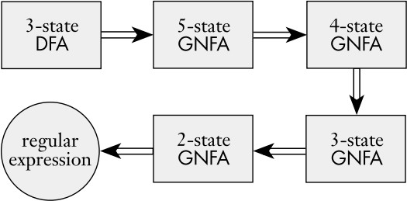
Steps to follow
Lecturer Saifur Rahman, Dept. of CSE, United International University

Slide 35
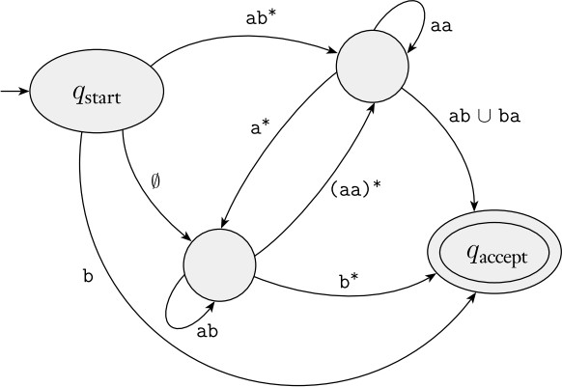
A GGNFANis aFnAondeterministic finite automaton(NFA) in which each transition is labeled with a regular expression
over the alphabet set instead of only members of the
alphabet or 𝜀.
A single initial state with all possible outgoing transitions and no incoming transitions.
A single final state without outgoing transitions but all possible incoming transitions. The accept state is not the same as the start state.
A single transition between every two states, including self loops.
Lecturer Saifur Rahman, Dept. of CSE, United International University

Slide 36
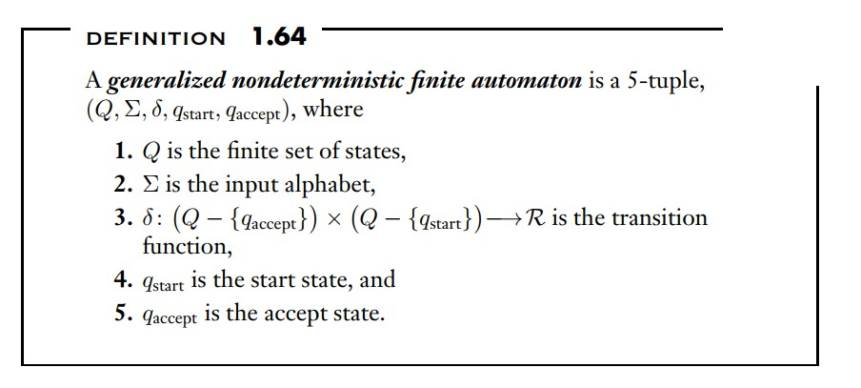
Formal Definition
Lecturer Saifur Rahman, Dept. of CSE, United International University

Slide 37
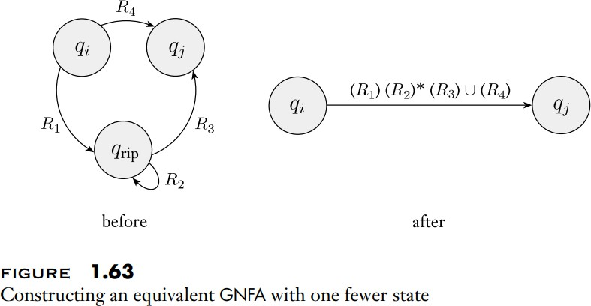
GNFA – State Minimization Rule
Lecturer Saifur Rahman, Dept. of CSE, United International University

Slide 38
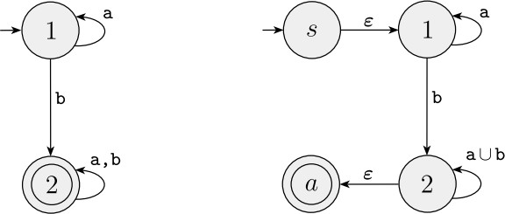
DFA → GNFA – Steps to follow
Add a new start state with an 𝜀 arrow to the old start state
Add a new accept state with 𝜀 arrows from the old accept states to this new accept state
If any arrows have multiple labels, replace each with a single arrow whose label is the union of the previous labels
Add arrows labeled 𝜙 between states that had no arrows. [better no to show this in the diagram, for simplicity]
Lecturer Saifur Rahman, Dept. of CSE, United International University

Slide 39
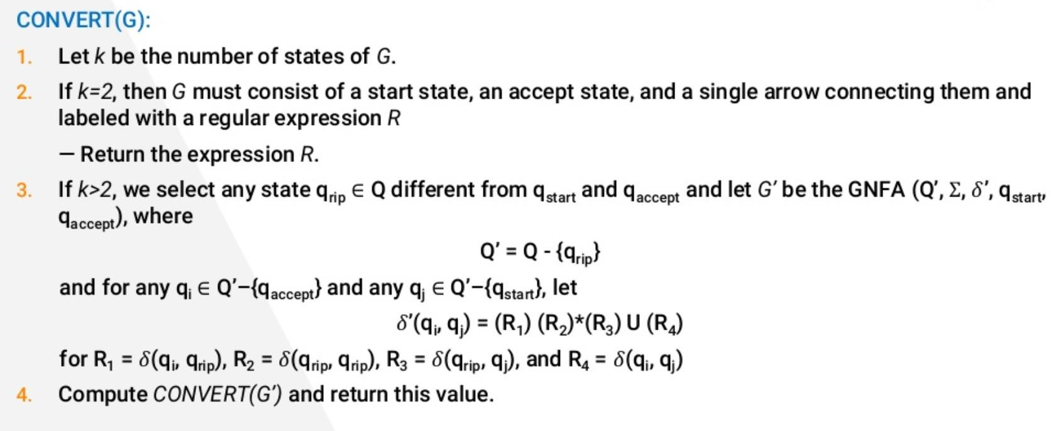
GNFA → RE - Algorithm
Lecturer Saifur Rahman, Dept. of CSE, United International University

Slide 40
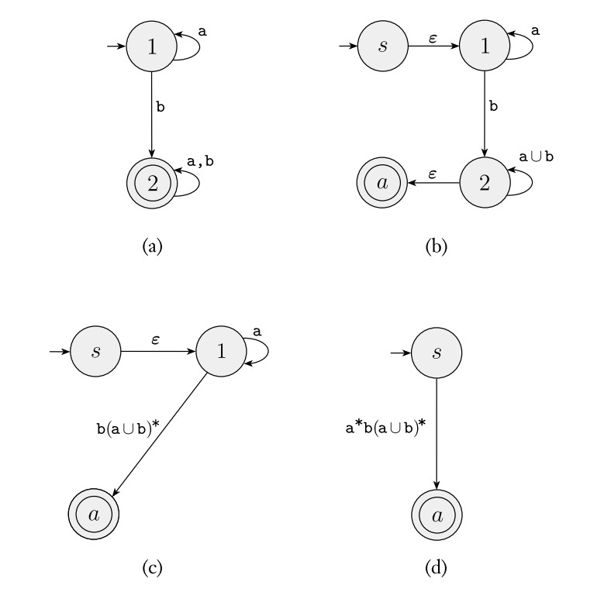
GNFA → RE
Lecturer Saifur Rahman, Dept. of CSE, United International University

Slide 41
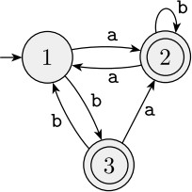
Example
Lecturer Saifur Rahman, Dept. of CSE, United International University

Slide 42
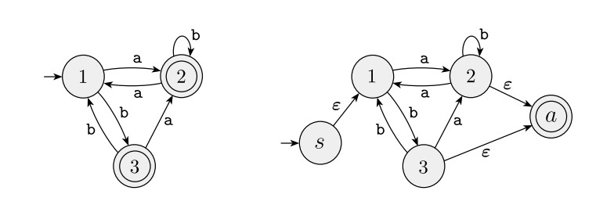
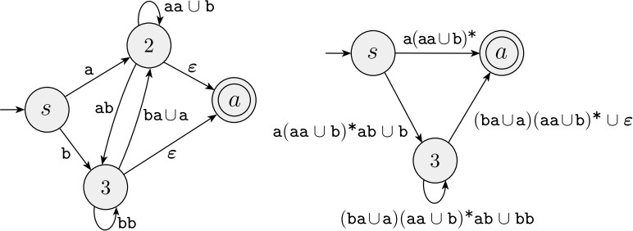
Lecturer Saifur Rahman, Dept. of CSE, United International University

Slide 43
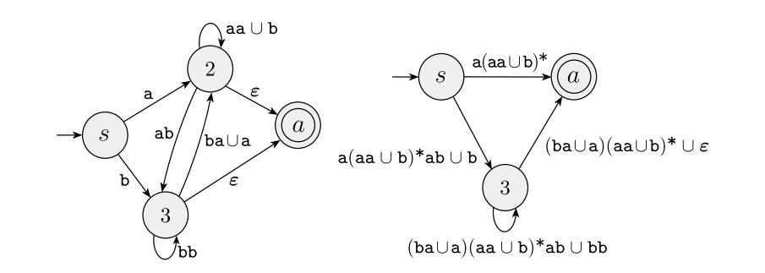
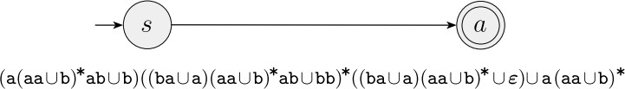
Lecturer Saifur Rahman, Dept. of CSE, United International University

Slide 44
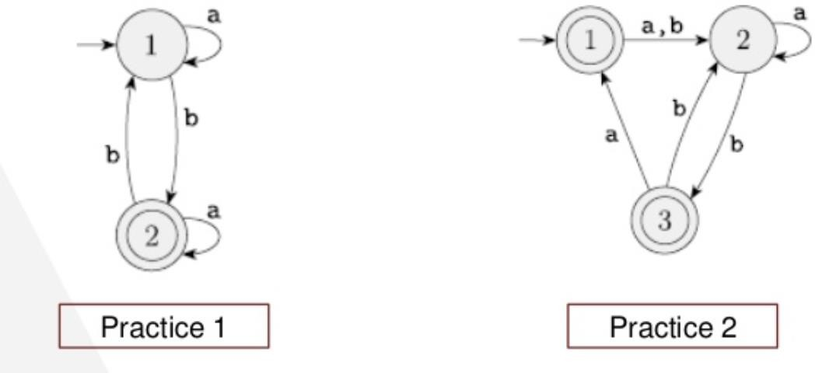
DFA → GNFA → RE : Practices
Lecturer Saifur Rahman, Dept. of CSE, United International University

